Slide 1
Chapter 10
Differential Equations:
Laplace Transform Methods
The Laplace transform was developed by the French mathematician by the same name (1749-1827) and was widely adapted to engineering problems in the last century. Its utility lies in the ability to convert differential equations to algebraic forms that are more easily solved. The notation has become very common in certain areas as a form of engineering “language” for dealing with systems.

Slide 2
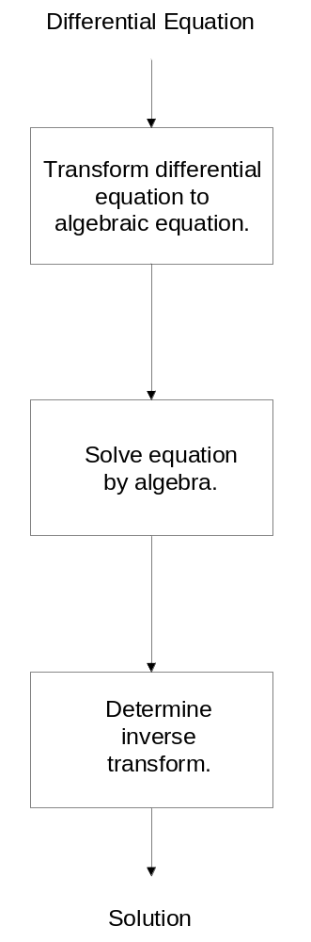
Figure 10-1.
Steps involved in using the
Laplace transform.

Slide 3
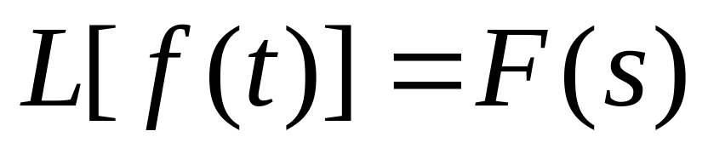
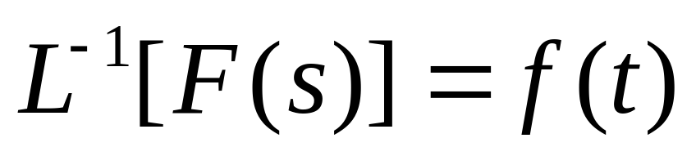
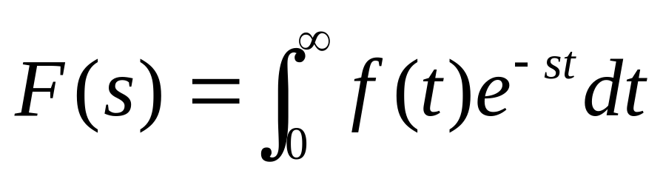
Laplace Transformation

Slide 4
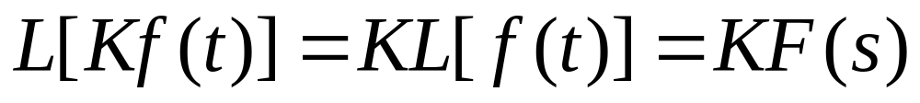
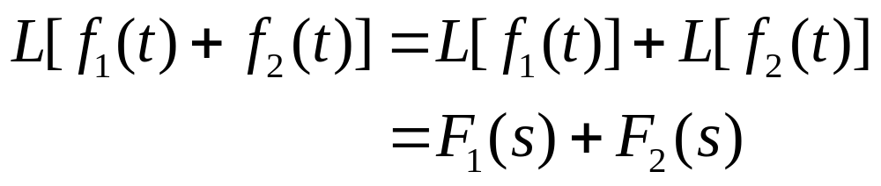
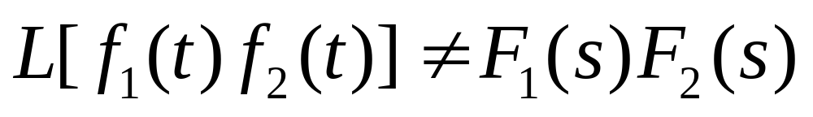
Basic Theorems of Linearity
The Laplace transform of a product is not the product of the transforms.

Slide 5
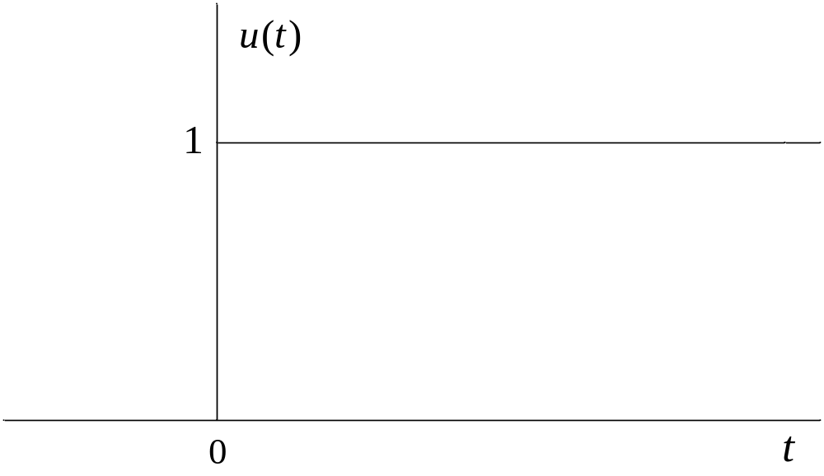
Figure 10-2. Illustration of the unit step function.

Slide 6
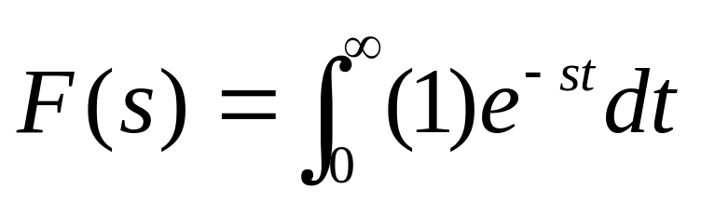
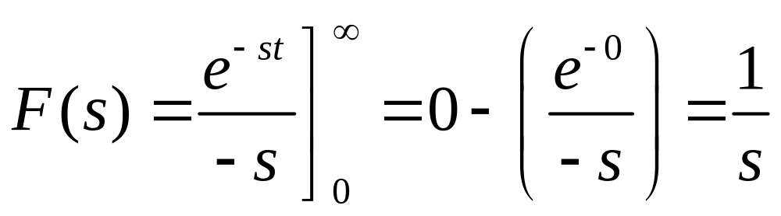
Example 10-1. Derive the Laplace transform of the unit step function.

Slide 7
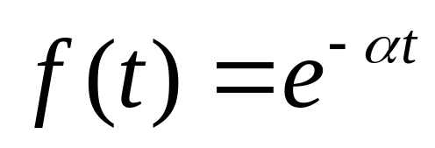
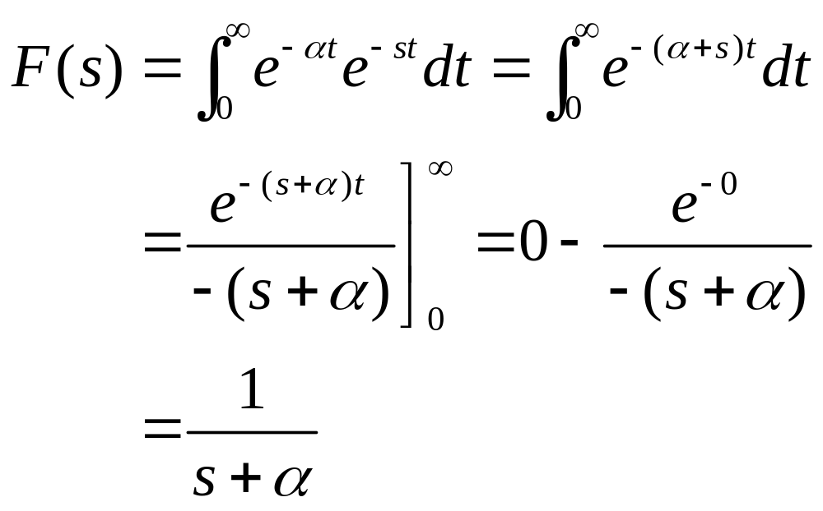
Example 10-2. Derive the Laplace transform of the exponential function

Slide 8
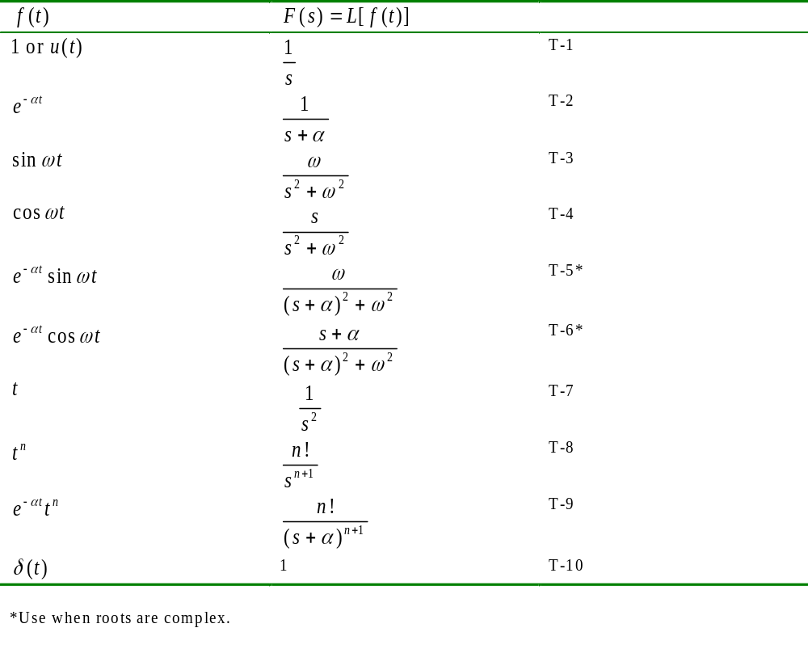
Table 10-1. Common transform pairs.

Slide 9
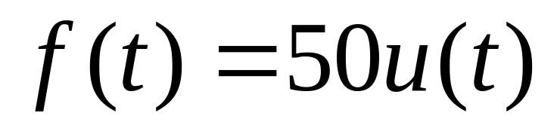
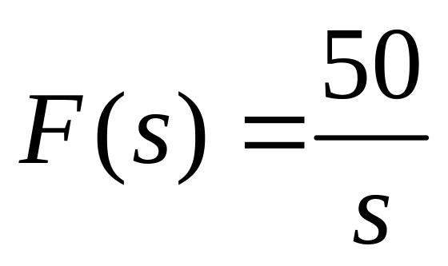
Example 10-3. A force in newtons (N) is given below. Determine the Laplace transform.

Slide 10
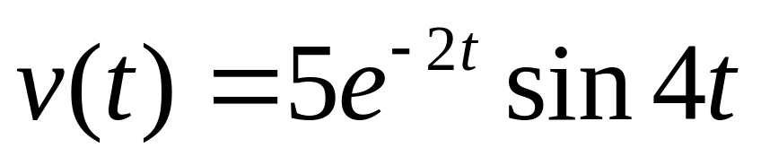
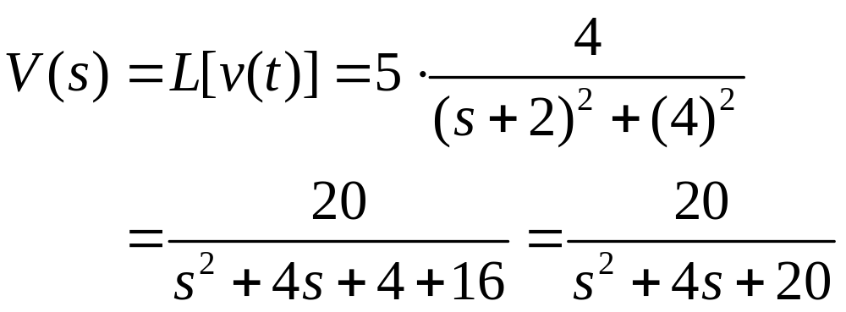
Example 10-4. A voltage in volts (V) starting at t = 0 is given below. Determine the Laplace transform.

Slide 11
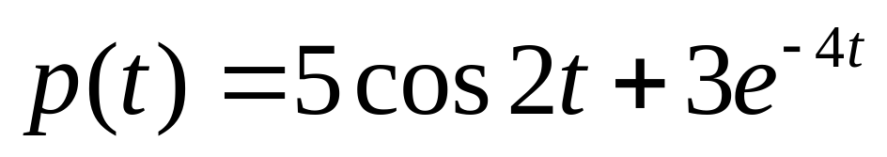
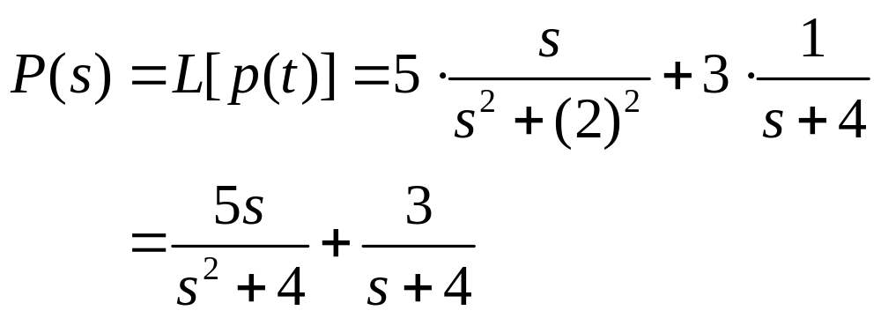
Example 10-5. A pressure in pascals (p) starting at t = 0 is given below. Determine the Laplace transform.

Slide 12
Inverse Laplace Transforms by Identification
When a differential equation is solved by Laplace transforms, the solution is obtained as a function of the variable s. The inverse transform must be formed in order to determine the time response. The simplest forms are those that can be recognized within the tables and a few of those will now be considered.

Slide 13
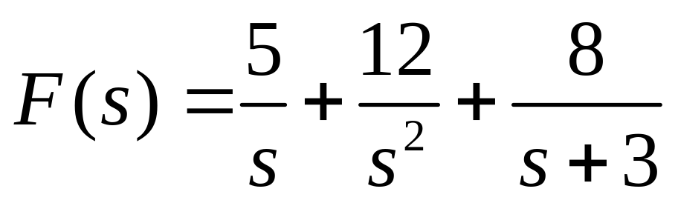
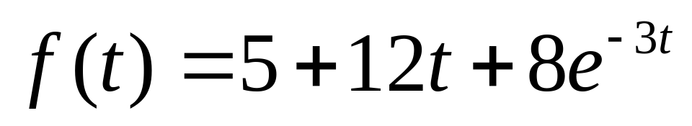
Example 10-6. Determine the inverse transform of the function below.

Slide 14
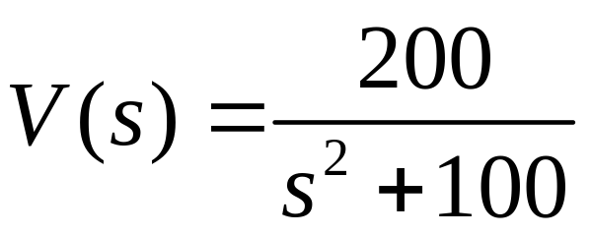
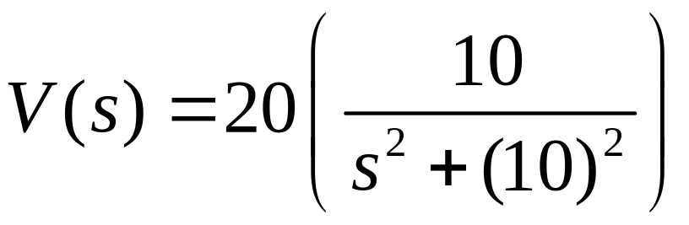
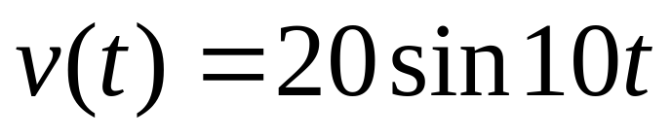
Example 10-7. Determine the inverse transform of the function below.

Slide 15
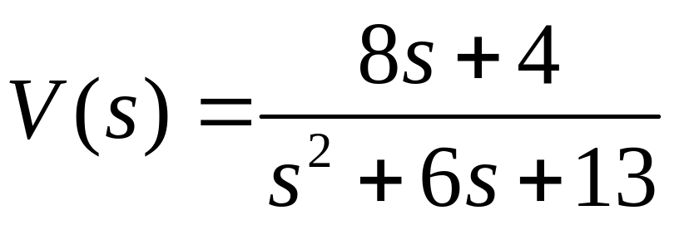
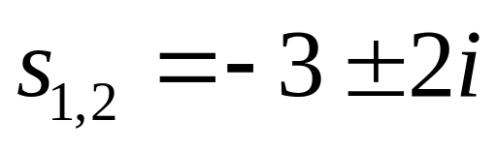
Example 10-8. Determine the inverse transform of the function below.
When the denominator contains a quadratic, check the roots. If they are real, a partial fraction expansion will be required. If they are complex, the table may be used. In this case, the roots are

Slide 16
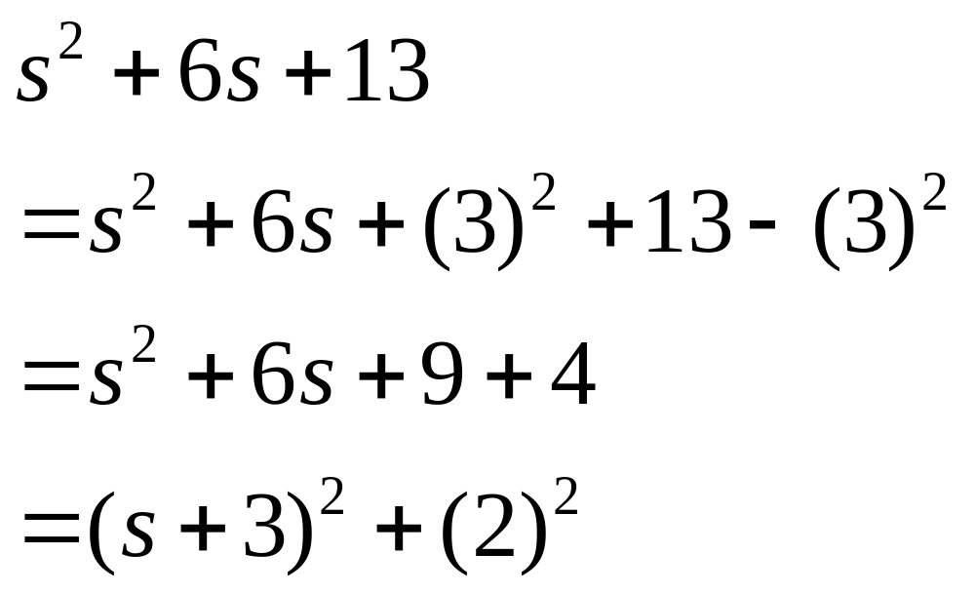
Example 10-8. Continuation.

Slide 17
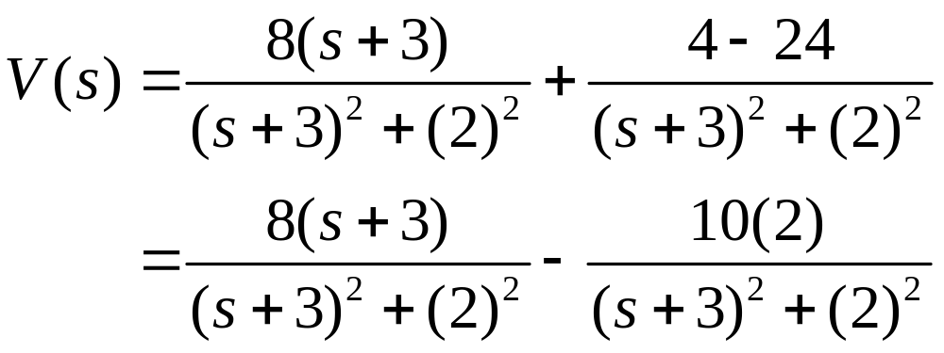
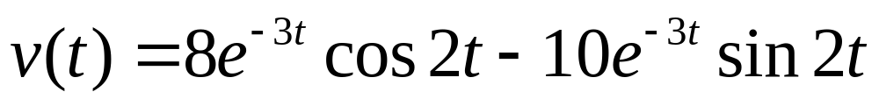
Example 10-8. Continuation.

Slide 18
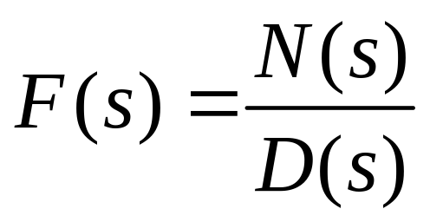
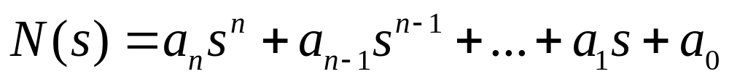
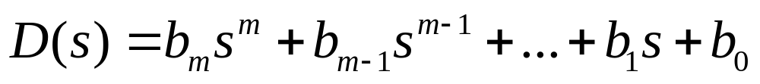
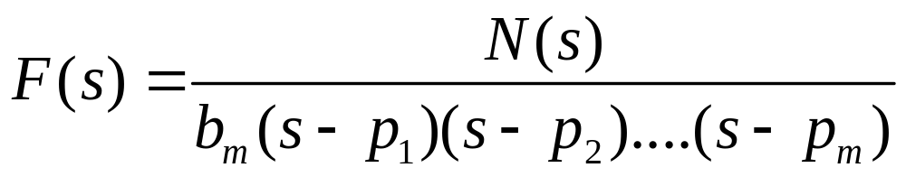
Forms for CCLODE Transforms

Slide 19
The roots of D(s) are called poles and they may be classified in four ways.
1. Real poles of first order.
2. Complex poles of first order (including purely imaginary poles)
3. Real poles of multiple order
4. Complex poles of multiple order (including purely imaginary poles)

Slide 20
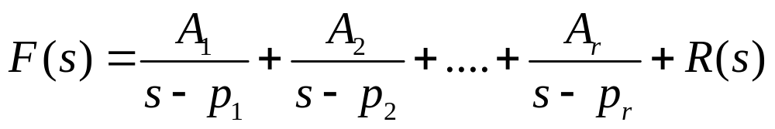
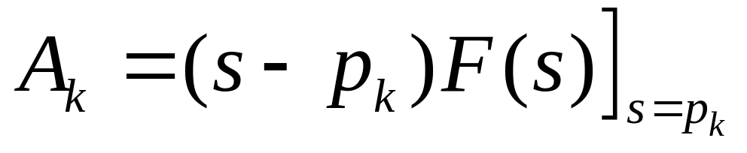
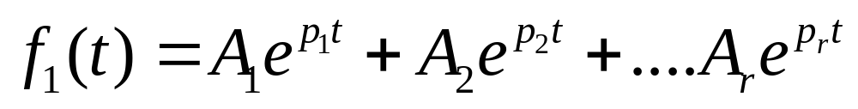
Partial Fraction Expansion
Real Poles of First Order

Slide 21
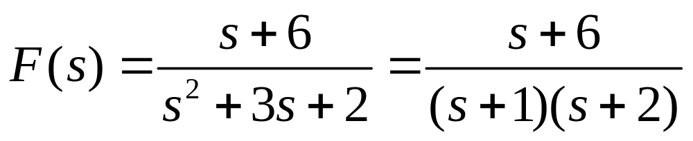
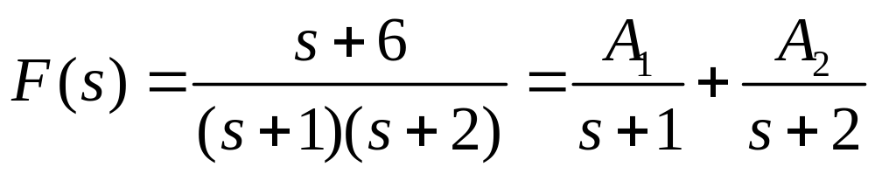
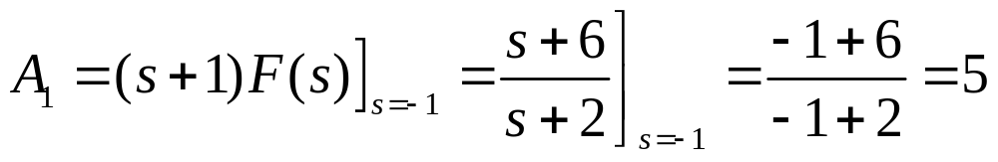
Example 10-9. Determine inverse transform of function below.

Slide 22
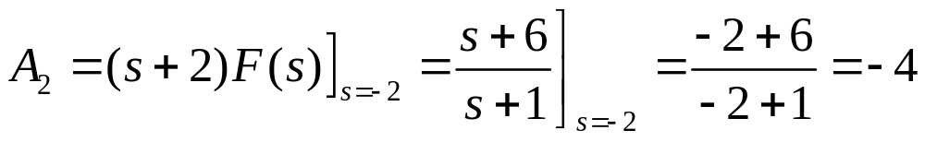
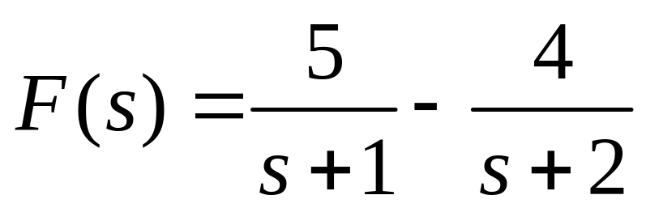
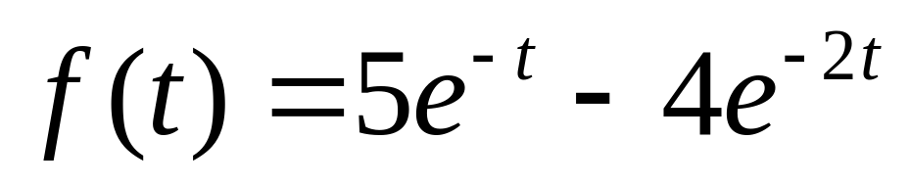
Example 10-9. Continuation.

Slide 23
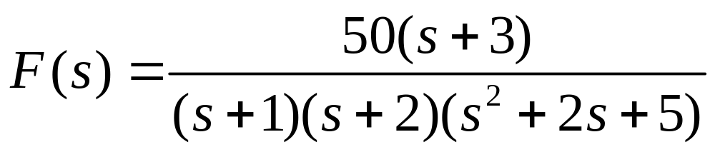
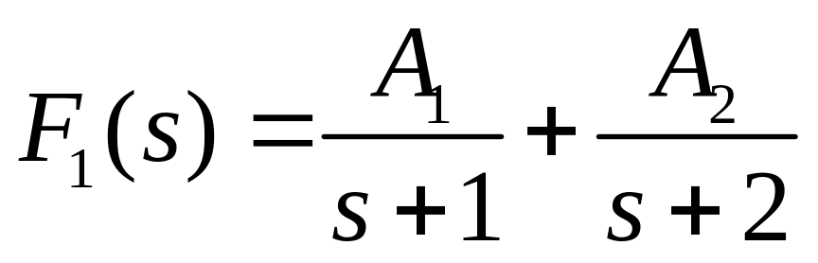
Example 10-10. Determine exponential portion of inverse transform of function below.

Slide 24
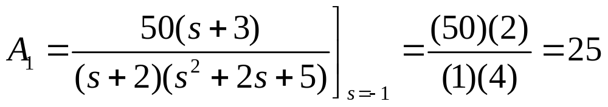
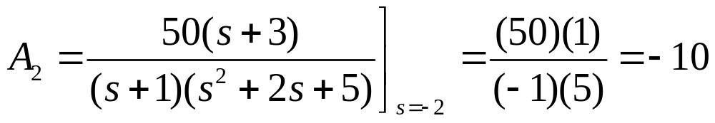
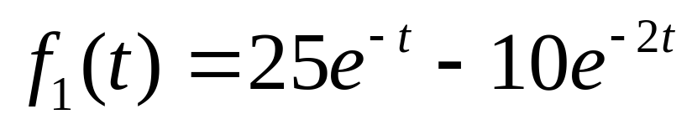
Example 10-10. Continuation.

Slide 25
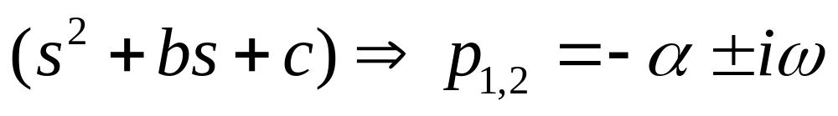
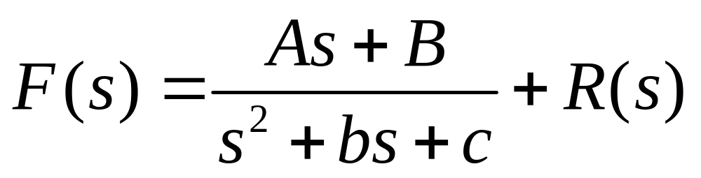
Partial Fraction Expansion for
First-Order Complex Poles

Slide 26
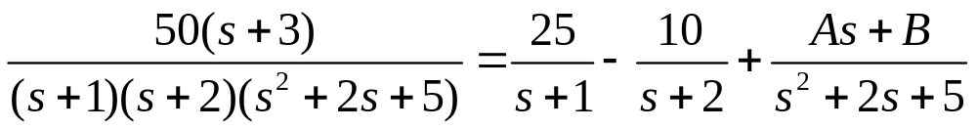





Example 10-11. Complete the inverse transform of Example 10-10.

Slide 27



Example 10-11. Continuation.

Slide 28



Second-Order Real Poles
Assume that F(s) contains a denominator factor of the form (s+α)². The expansion will take the form shown below.

Slide 29




Example 10-12. Determine inverse transform of function below.

Slide 30




Example 10-12. Continuation.

Slide 31

Laplace Transform Operations

Slide 32



Significant Operations for Solving Differential Equations

Slide 33




Procedure for Solving DEs

Slide 34






Example 10-13. Solve DE shown below.

Slide 35





Example 10-13. Continuation.

Slide 36





Example 10-14. Solve DE shown below.

Slide 37






Example 10-14. Continuation.

Slide 38


Example 10-14. Continuation.

Slide 39




Example 10-15. Solve DE shown below.

Slide 40




Example 10-15. Continuation.

Slide 41




Example 10-16. Solve DE shown below.

Slide 42





Example 10-16. Continuation.

Slide 43



Example 10-16. Continuation.

